Slide 1
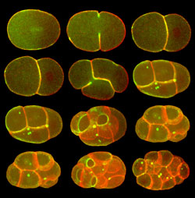
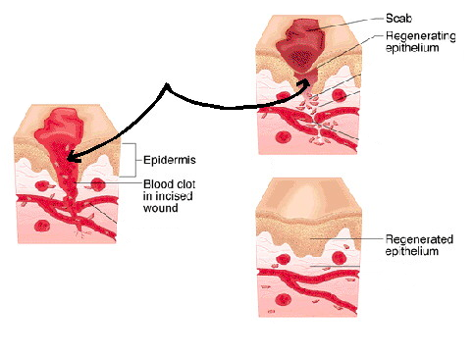
Cell Division—Mitosis
Cell Division — process by which a cell divides into 2 new cells
-Why do cells need to divide?
Living things grow by producing more cells, NOT because each cell increases in size
Repair of damaged tissue

Slide 2
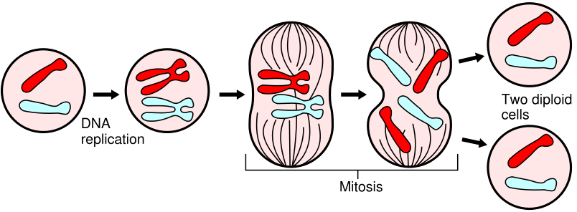
The original cell is called the parent cell;
  2 new cells are called daughter cells
Before cell division occurs , the cell replicates (copies) all of its DNA, so each daughter cell gets complete set of genetic information from parent cell
Each daughter cell is exactly like the parent cell – same kind and number of chromosomes as the original cell
2 Daughter Cells
Parent Cell

Slide 3
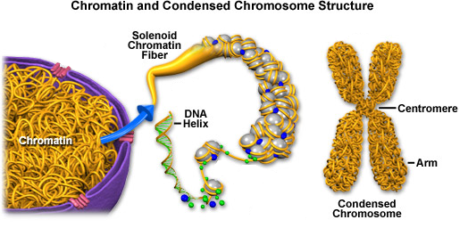
DNA
DNA is located in the nucleus and controls all cell activities including cell division
When NOT dividing, DNA is long and thread-like, wrapped around histones and in a form called chromatin.
Just prior to dividing, DNA is replicated, coiled, shortened form called a chromosome

Slide 4
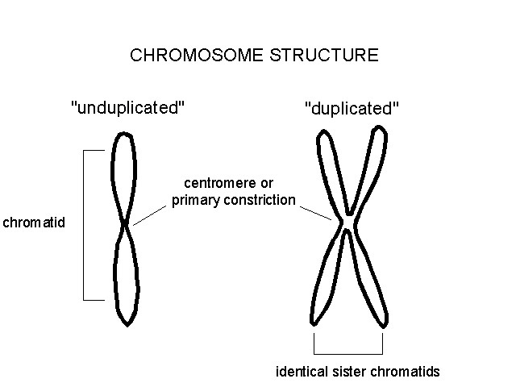
  2 identical “sister” chromatids attached at an area in the middle called a centromere
  When cells divide, “sister” chromatids separate and 1 goes to each new cell

Slide 5
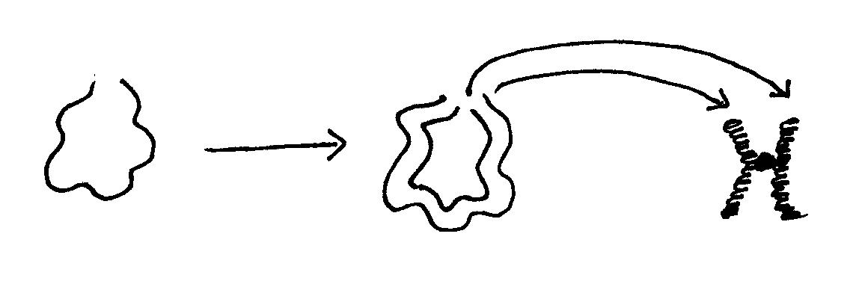
Chromatin to chromosomes illustration:
Chromatin
Coils up into chromosomes
Duplicates itself
Replicated CHROMOSOME
CHROMOSOME
Why does DNA need to change from chromatin to chromosome?
More efficient division

Slide 6
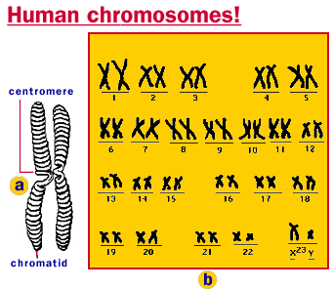
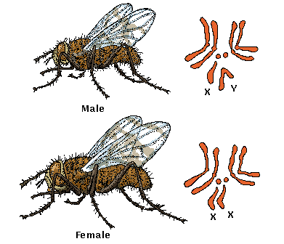
All (body) cells in an organism have the same kind and number of chromosomes
Examples: Human = 46 chromosomes
Human skin cell = 46 chromosomes
Human heart cell = 46 chromosomes
Human muscle cell = 46 chromosomes
Fruit fly = 8 chromosomes
Fruit fly skin cell = 8 chromosomes
Fruit fly heart cell = 8 chromosomes
Fruit fly muscle cell = 8 chromosomes

Slide 7
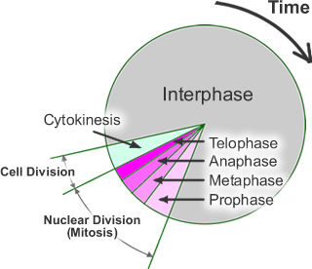
CELL CYCLE
Cell Cycle -- series of events cells go through as they grow and divide
Cell grows, prepares for division, then divides to form 2 daughter cells – each of which then begins the cycle again

Slide 8
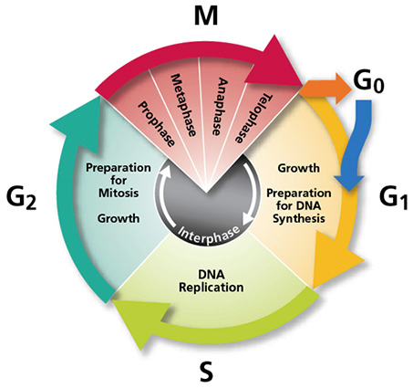

Slide 9

NORMAL Cell Division Control
G1 Phase- Most of
cell life, makes more organelles and proteins
S (Synthesis) phase- DNA is Replicated
G2 Phase- prepares for mitosis
M(mitosis)- cell divides

Slide 10
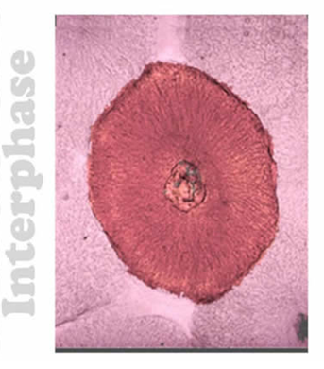
Interphase—period of cell growth and development
DNA replication (copying) occurs during Interphase
During Interphase the cell also grows, carries out normal cell activities, replicates all other organelles
The cell spends most of its life cycle in Interphase

Slide 11
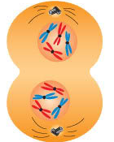
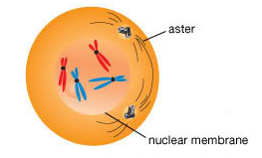
Mitosis – division of the nucleus into 2 nuclei, each with the same number of chromosomes
Mitosis occurs in all the somatic (body) cells
Why does mitosis occur?
So each new daughter cell has nucleus with a complete set of chromosomes

Slide 12
Summary: Cell Cycle
Interphase Mitosis (PMAT) Cytokinesis
When cells become old or damaged, they die and are replaced with new cells

Slide 13
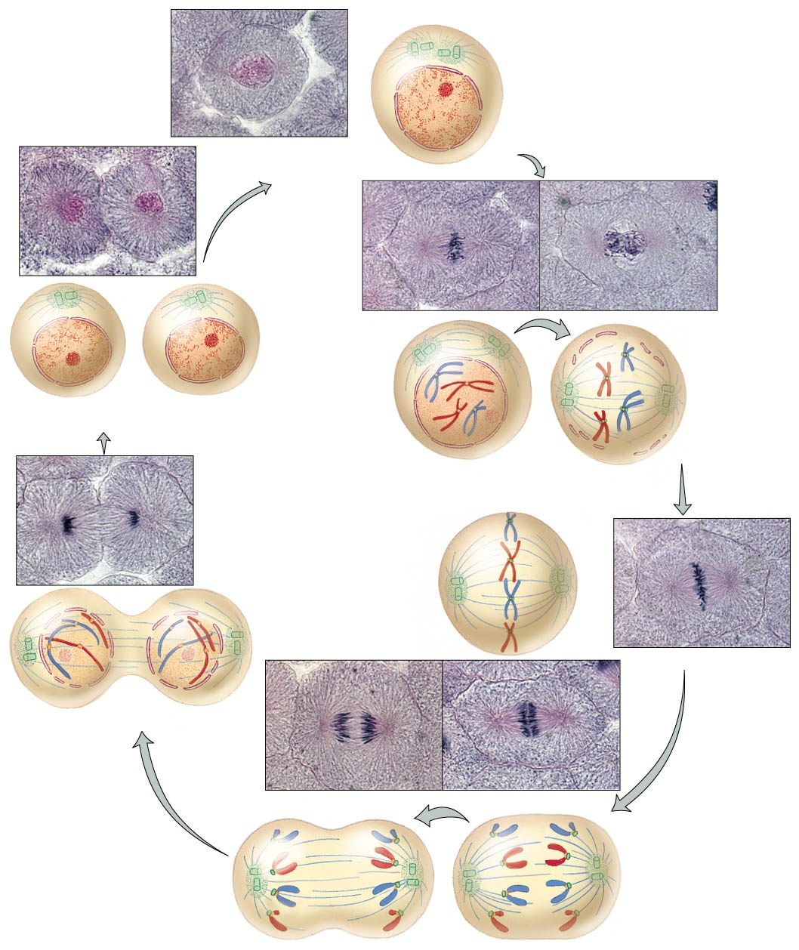

Slide 14
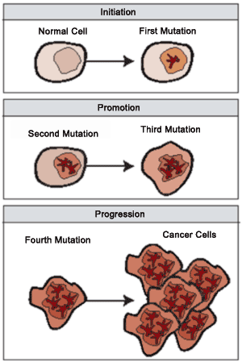
Cell Division Control
DNA controls all cell activities including cell division
Some cells lose their ability to control their rate of cell division – the DNA of these cells has become damaged or changed (mutated)
These super-dividing cells form masses called tumors

Slide 16
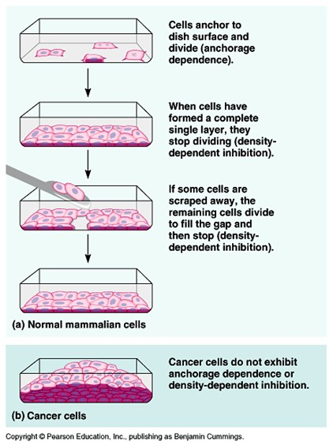

Slide 17
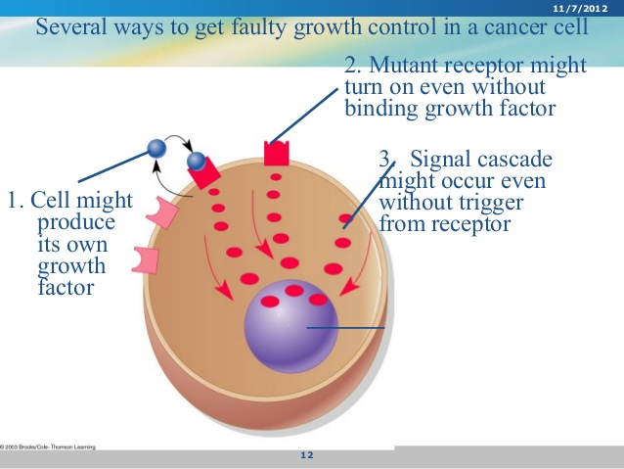

Slide 18
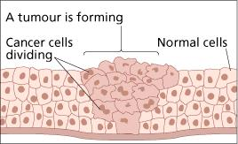
Benign tumors are not cancerous – these cells do not spread to other parts of the body
Malignant tumors are cancerous – these cells break loose and can invade and destroy healthy tissue in other parts of the body (called metastasis)

Slide 19
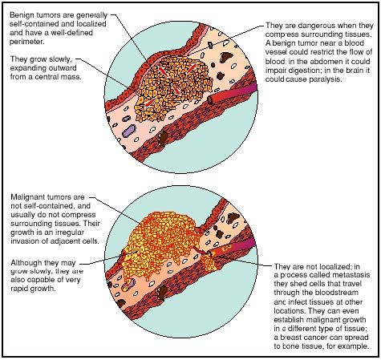

Slide 20
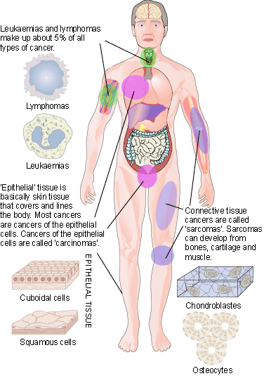
Cancer is not just one disease, but many diseases – over 100 different types of cancers

