Slide 2
1. How much did an ounce of gold cost on Nov 17?
$ 1725

Slide 3
2. When did gold cost the most?
9 / 8 /11

Slide 4
3. When did gold cost $1500?
6 / 30 /11

Slide 5
During which 10 day period did the price of gold decrease the most?
Sept 18-28

Slide 6
$1820
Profit for 1 ounce:
$1820 – $1500 = $320
$1500
If you bought 3 ounces of gold on June 30 and sold it on Sept 8, how much would you profit?
$320 x 3 =
$960

Slide 7
1. Which snack is the most popular?
chips

Slide 8
2. Which snack do only 4% of people prefer?
carrots

Slide 9
3. What percentage of people prefer sweet
snacks?
29 + 19 =
48%

Slide 10
If 200 people were polled, how many of them
prefer pretzels?
200 X .12 =
24
Notes:
You could set this up as a proportion: x/200 = 12/100

Slide 11
5. If 350 people were polled, how many of them
prefer chips?
350 X .36 =
126

Slide 12
1. How many hours does the heater run on
a Tuesday?
7.5 hr

Slide 13
2. Which object runs 11 hours on a Saturday?
TV

Slide 14
6 hr
5 ½ hr
7 hr
5 ½ hr
3. Which object has the biggest difference
between weekdays and weekends?
computer

Slide 15
4. Why do you think there is a difference
between weekends and weekdays?
Many people are at work or school on weekdays

Slide 16
5. If this graph is for winter electricity usage,
how do you think it would be different for
summer?
The heater might run less. The computer, lights, and TV could run more if students aren’t at school

Slide 17
What were the company’s profits in May of 2011?
$5700

Slide 18
2. What were the company’s profits in June of
2011?
$10,900

Slide 19
$10900
$10700
$9700
$9800
$5700
$2700
$1200
$1200
$1100
$1200
$1100
$1000
3. What was the company’s total profit in 2011?
Add profits from all 12 months
$56,300

Slide 20
4. If the company is in Pennsylvania, do you
think they do snow removal or pool
maintenance? Why?
Pool maintenance since profits are high in summer

Slide 21
5. How would the company’s profits be different
if they were located in Florida?
Profits would be even year-round and maybe higher since more people have pools in FL than PA

Slide 22
1. Which state has the highest population?
Arizona

Slide 23
2. Which state has the lowest population?
New Mexico

Slide 24
3. How many people live in Colorado?
5,029,000

Slide 25
2.059 + 2.763 + 5.029 + 6.392
How many people live in the Four Corners states?
16,243,000

Slide 26
What percentage of the people in the Four Corners states live in New Mexico?
2,059,000
16,243,000
12.7%

Slide 27
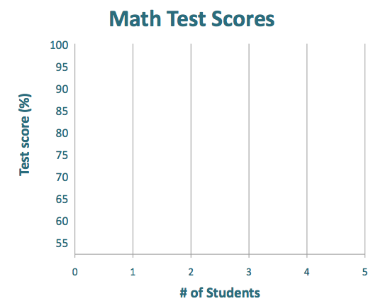
1. How many students earned 90% on the test?
4

Slide 28
2. If a B is 80-89%, how many students earned
Bs?
8

Slide 29
1
2
4
5
3
1
3
2
2
3. How many students are in the class?
23
1 + 2 + 4 + 5 + 3 + 1 + 3 + 2 + 2 =

Slide 30
4. If a 65% is needed to pass, how many students
failed the test?
2

Slide 31
21
23
5. What percent of the class passed the test?
91.3%

Slide 32
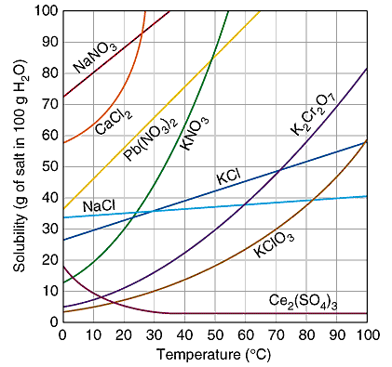
Graph shows how much can be dissolved in 100g of water
How many grams of K₂Cr₂O₇ can dissolve in 100 g of 50° water?
30g

Slide 33
2. Which compound can dissolve the most grams
in 10° water?
NaNO₃

Slide 34
3. What is the temperature if 75 g of Pb(NO₃)₂
will dissolve in 100 g of water?
40°

Slide 35
4. Which compound can dissolve 43 g in 100 g
of 53° water?
KCl

Slide 36
75 g
30 g
45g
5. One hundred grams of 20° water is saturated
with KNO₃. How many additional grams can be
dissolved if the temperature is raised to 45°?

Slide 37
5.9 m
1. What is the position at t = 11s?

Slide 38
2. What distance was traveled from t = 3s to 5s?
5 m
From 3m to 8m

Slide 39
3. During what time intervals was there no
motion?
0-3 s
,5-8 s
,& 15-17 s

Slide 40
5 m in 2 s
5 m in 7 s
3 m in 3 s
4. During which time interval was motion the
slowest?
8 – 15 s

Slide 41
5. What distance was traveled from t = 17s to
20s?
3 m

