Slide 1
Speciation Regular Bio 15-16

Slide 2
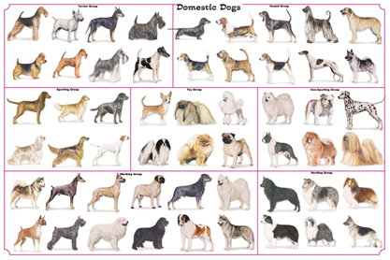
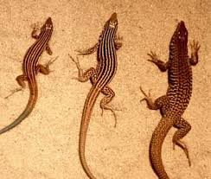
Genetic Variation:
All the inherited genetic variations of a population are inherited from its parents.
So the environment doesn’t cause the change in traits of an organism, it just determines which traits are best.
Populations with more genetic diversity have a better chance of some members surviving environmental changes.

Slide 3
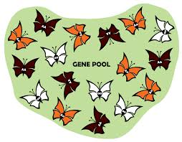
Gene Pool
Is all the different alleles(genes) in a population. EX: long fur, short fur, medium fur, etc

Slide 4
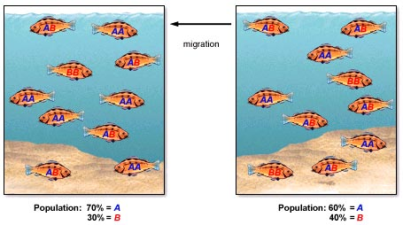
Allele Frequency
Just a count of how common an allele is in a population

Slide 5
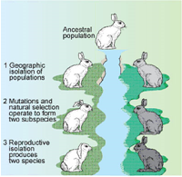
Geographic Isolation
Members of a population are separated from the rest of the population by physical barriers. EX: ocean, mountains, canyon, rivers, etc.

Slide 6
Speciation
Sometimes caused by geographic isolation, this is the slow, gradual formation of a different and new species

